Slide 1
System Administration: Initial Design Christian, Christopher, Mason, Mckay, and Stuart

Slide 2
Overview
Problem:
Spicy Cluck Co. needs a new regional office in Provo, Utah
Solution:
We’ve thoroughly designed a system that will meet all company needs

Slide 3
Technology List Router (OPNSense) Firewall (OPNSense) DNS (BIND) IDS/IPS/SIEM (Wazuh) Web Server (Apache) VPN (OPNSense) File Server (TrueNAS) Database (MySQL) Backup and Restore Solution (Duplicati) DHCP Server (OPNSense) Metric Server (Node exporter, Prometheus, Grafana)
System Architecture (1 of 2)

Slide 4
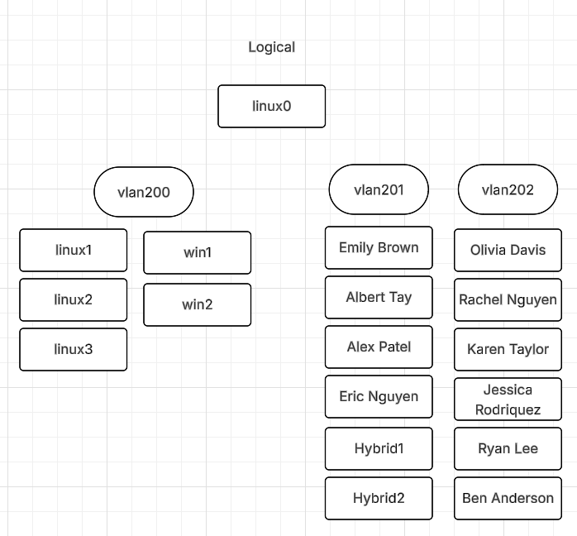
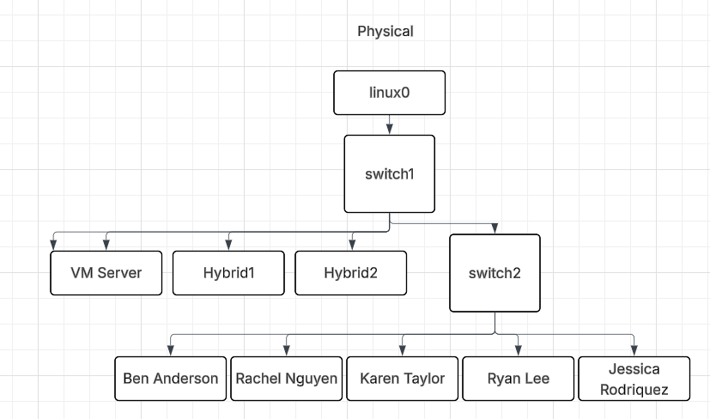
System Architecture (2 of 2)

Slide 5
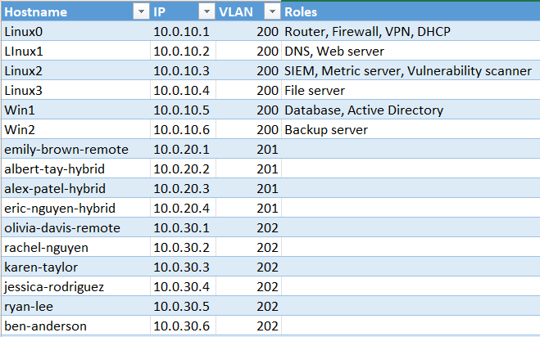
Configuration Plans
Firewall Rules Allow WAN → Web Server TCP 443/80, Allow VLAN 201 → Web Server TCP 22/3389, Deny all else, Allow Web Servers → Database TCP 3306, Allow VLAN 201 → Database TCP 3306, Deny all else, Allow VLAN 201 → File Server TCP 445/139, Allow VLAN 202 → File Server TCP 445/139, Allow VLAN 201 → SIEM TCP 514/443, Allow SIEM → all servers for log collection, Deny all else, Allow VLAN 201 → Backup TCP 22/873/445, Deny all else, Allow VLAN 201 → all servers (necessary ports only), Allow Admin → VPN TCP 1194, Deny all else
Allow VLAN 201 → all servers (necessary ports only), Deny all other access
Allow VLAN 202 → DNS TCP/UDP 53, Allow VLAN 202 → Web TCP 80/443, Deny inter-VLAN traffic Allow VLAN 201 → all servers (necessary ports only), Deny all other access Allow VLAN 202 → DNS TCP/UDP 53, Allow VLAN 202 → Web TCP 80/443, Deny inter-VLAN traffic

Slide 6
Implementation Strategy
Responsibilities:
Come to class
Do your fair share of work
Triple check rubrics
If the group asks you to do something, get it done
Timeline:
27 Sep Milestone 1: Design
18 Oct Milestone 2: VM & Network
15 Nov Milestone 3: AD, LDAP, etc.
29 Nov Milestone 4: Systems up
6 Dec Milestone 5: Backups up
17 Dec Milestone 6: Final Presentation

Slide 7
Testing & Validation
Verify logins, DNS resolution, DHCP leases, GPO enforcement, firewall rules, web server and VPM accessibility, DB and backup functionality.
Success = Services are all running properly. All users can access exactly what they should be able to access.

Slide 8
Risks & Mitigation
Potential Challenges:
Lack of knowledge
Hardware failure/inadequacy
Lack of time
Mitigation Techniques:
Ask Google, Chat, or each other.
Get an extra of everything. Be prepared to take a surprise trip back to surplus.
Get ahead of the milestones.

Slide 9


Expected Outcomes
Spicy Cluck Co. will be well connected. All employees will have access to exactly what they need, and we will do well too.

Slide 10
Thank you
Questions?

